Slide 1

Internet Explained
SoftUni Team
Technical Trainers
Software University
https://softuni.bg

Slide 2
Table of Content
Introduction to Internet
How does the Internet work?
Packets - Sending and Receiving Information
Internet Protocol
Reliability and TCP
The OSI Model
Network Hardware
The Future of the Internet

Slide 3
Have a Question?
sli.do
#java-web

Slide 4

Introduction to Internet
An Introduction to the Internet

Slide 5
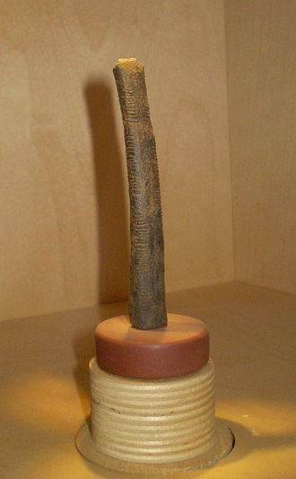
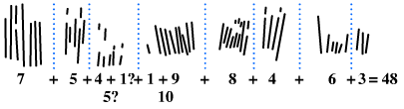
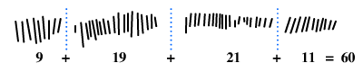
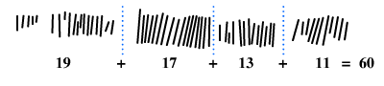
Ishango Bone
The Ishango bone is a bone tool and possible mathematical object, dated to the Upper Paleolithic era.
The etchings on the bone are in three columns with marks asymmetrically grouped into sets, leading hypotheses such as that the implement indicates an understanding of decimals or prime numbers

Slide 6
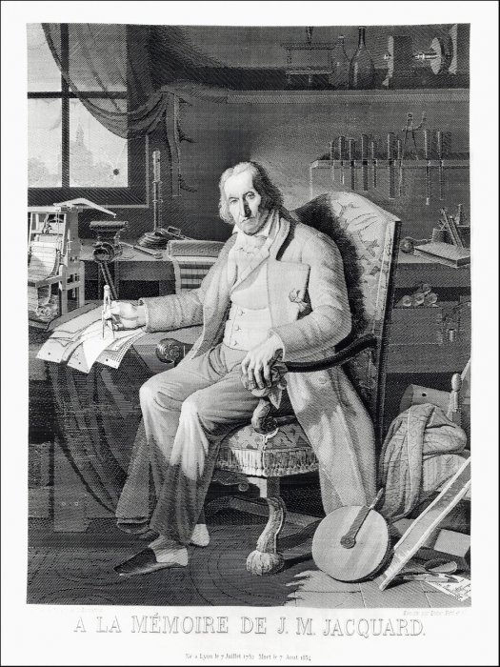
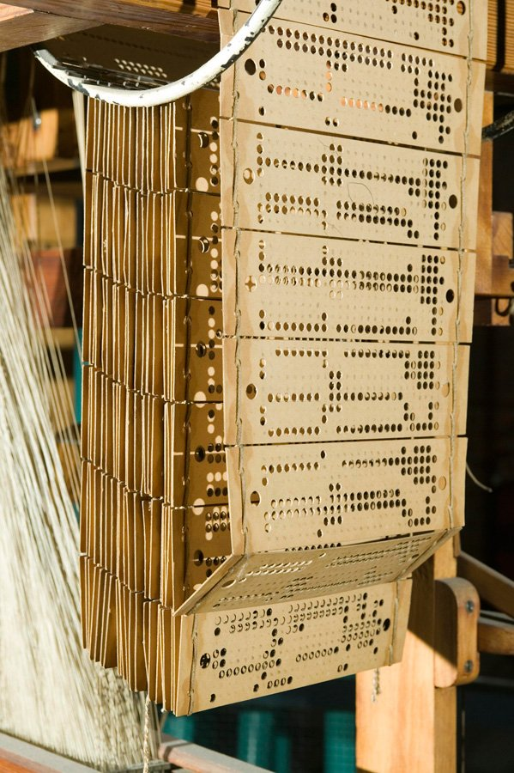
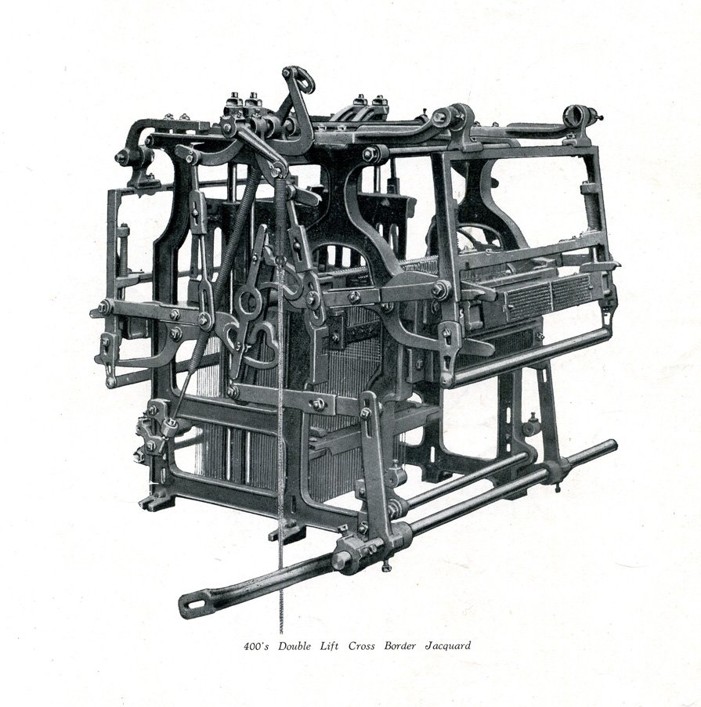
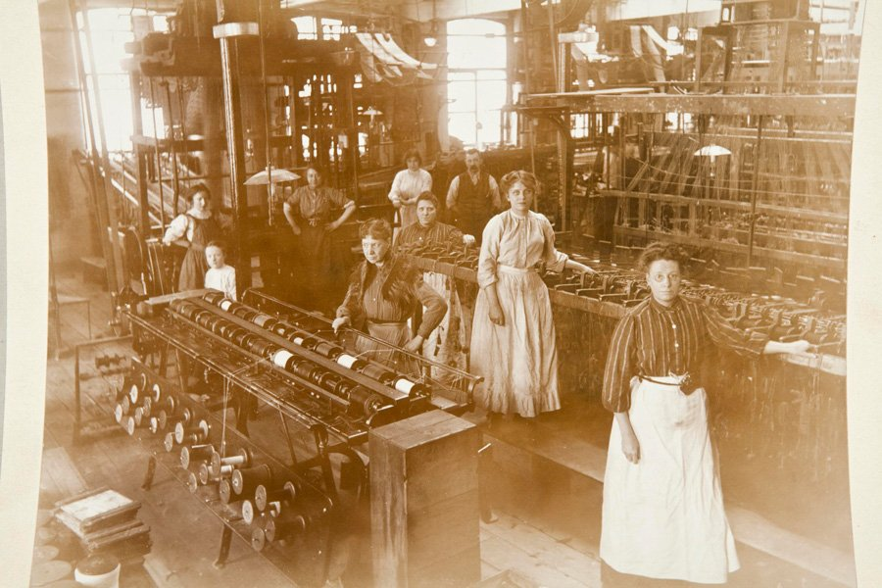
Jacquard machine
Joseph-Marie Jacquard, a French weaver and merchant, patented his invention in 1804.
Machine use of interchangeable cards, upon which small holes were punched, which held instructions for weaving a pattern

Slide 7
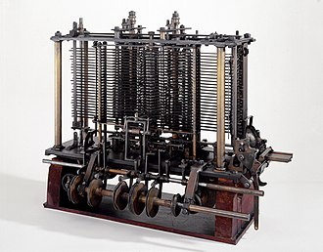
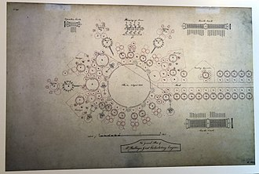
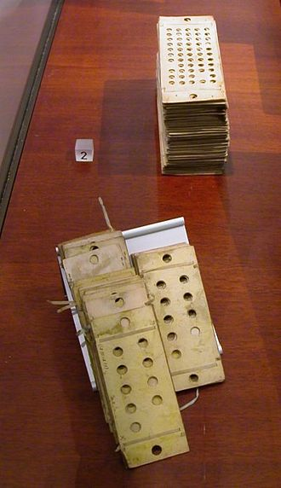
Analytical Engine
The Analytical Engine was a proposed mechanical general-purpose computer designed by English mathematician and computer pioneer Charles Babbage
The Analytical Engine incorporated an arithmetic logic unit, control flow in the form of conditional branching and loops, and integrated memory, making it the first design for a general-purpose computer that could be described in modern terms as Turing-complete

Slide 8
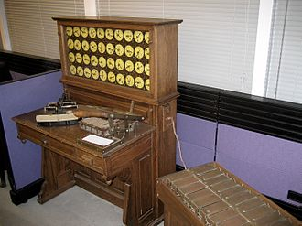
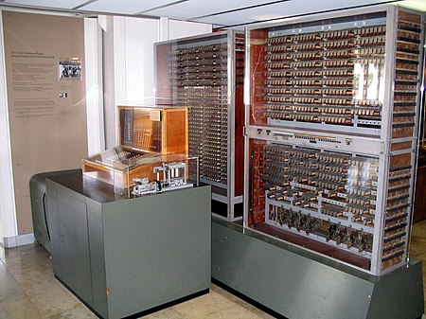
Tabulating machine & Z3
The Tabulating machine was an electromechanical machine designed to assist in summarizing information stored on punched cards.
Invented by Herman Hollerith
Later models were widely used for business applications such as accounting and inventory control
The Z3 was a German electromechanical computer designed by Konrad Zuse in 1935, and completed in 1941. It was the world's first working programmable, fully automatic digital computer.

Slide 9
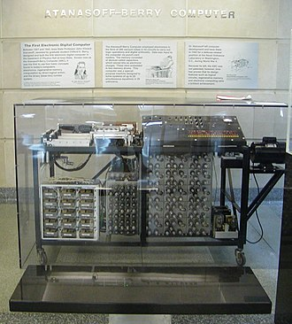
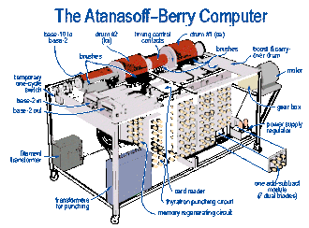
Atanasoff–Berry computer
The Atanasoff–Berry computer (ABC) was the first automatic electronic digital computer.
The ABC would be considered the first electronic ALU (Arithmetic Logic Unit) - which is integrated into every modern processor's design.
Its unique contribution was to make computing faster by being the first to use vacuum tubes to do the arithmetic calculations

Slide 10
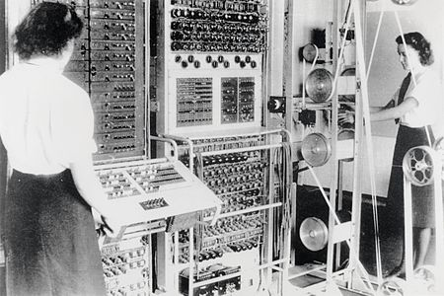

Colossus & ENIAC
Colossus was a set of computers developed by British codebreakers in the years 1943–1945 to help in the cryptanalysis of the Lorenz cipher.
Colossus used thermionic valves (vacuum tubes) to perform Boolean and counting operations.
Colossus is thus regarded as the world's first programmable, electronic, digital computer, although it was programmed by switches and plugs and not by a stored program.
ENIAC (Electronic Numerical Integrator and Computer) was the first programmable, electronic, general-purpose digital computer. It was Turing-complete and able to solve "a large class of numerical problems" through reprogramming.
Was designed and primarily used to calculate artillery firing tables for the United States Army's Ballistic Research Laboratory

Slide 11
Internet – History
Begins with the development of electronic computers in the 1950s.
Packet switching networks were developed in the late 1960
The internet protocol was developed in the 1970s
In the 1980s at CERN Tim Berners-Lee created the World Wide Web – the first website, linking hypertext documents into an information system, accessible from any node on the network

Slide 12
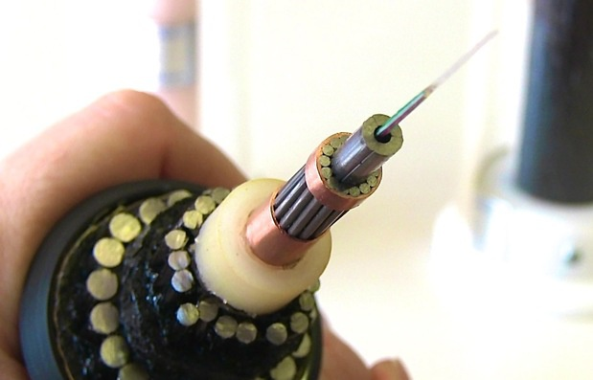
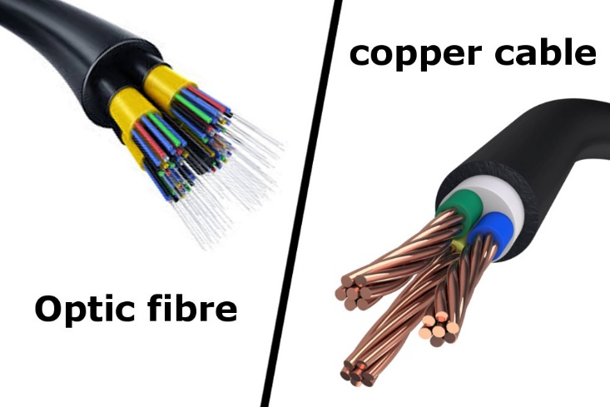
Internet – Introduction (1)
So, what is the Internet?
A simple answer to that question is a wire. A wire, which is buried into the ground or even in the ocean
That wire can be fiber optics, copper or occasionally beamed to satellites or through cell phone network

Slide 13

Internet – Introduction (2)
ISPs (Internet Service Providers) have access to such cables
We get indirectly connected to them though ISPs
The Internet is a network of networks. It connects billions of devices together all over the globe that are connected to this wire in one form or another

Slide 14
What is a Network?
Network - a group of two or more devices that can communicate
It is comprised of a number of different computer systems connected by physical and/or wireless connections
The scale can range from a single PC sharing out basic peripherals to massive data centers located around the World, to the Internet itself

Slide 15

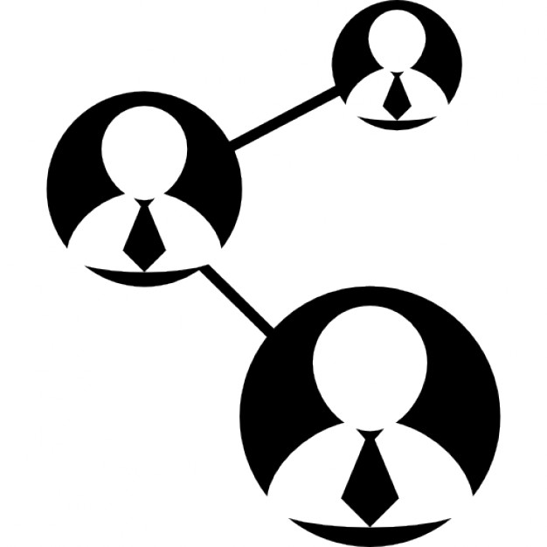

Networks and Internet
The internet is made of hundreds of thousands of networks and billions of computers and devices connected physically
These different systems connect to each other, communicate with each other and work together because of standards for how data is sent

Slide 16

How Does the Internet Work?

Slide 17



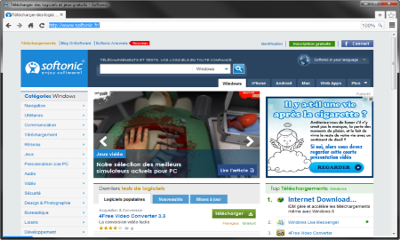





Web Server Work Model
Web Client
Web Server
Technology
Request
Response
Web Resources
Database
HTML, PDF, JPG…

Slide 18

Important Definitions
To understand how the Internet works, first we need to get acquainted with a few definitions
What is?
Server and Client
Network Protocol
Packets
TCP vs UDP

Slide 19

Servers and Clients
All of the machines on the Internet are either servers or clients
Servers are the machines that provide services to other machines
Clients are the machines that are used to connect to those services

Slide 20

Network Protocol
Network Protocol – a set of rules and standards, that allow communication between network devices
Network protocols include mechanisms for devices to identify and make connections with each other
Example for standard network protocols:
TCP, UDP, IP, ARP
HTTP, FTP, TFTP, SMPT, SSH

Slide 21
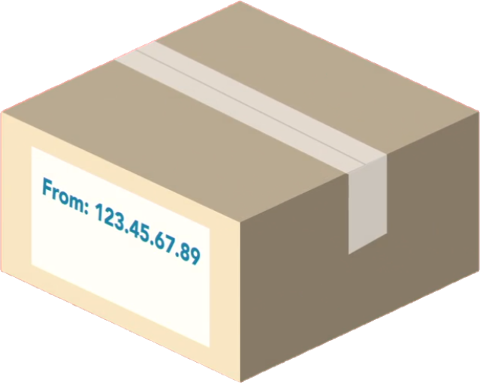
Packets
Sending and Receiving Information

Slide 22
Packets (1)
Everything that is created on a computer is translated into digital information using bits
Bits need to have a way to be transmitted over the internet
Every message, file or stream of information is broken down into small chunks called packets
When packets are sent on the internet, they usually travel the network together
But they might have to take a different route to get to the destination

Slide 23
Packets (2)
Each packet contains some important information inside of it called the header:
Where it came from
Where is it going
How long it is
This is how the packet is known to be complete
All the packets in the message are the same size
How many packets there are in the overall message

Slide 24
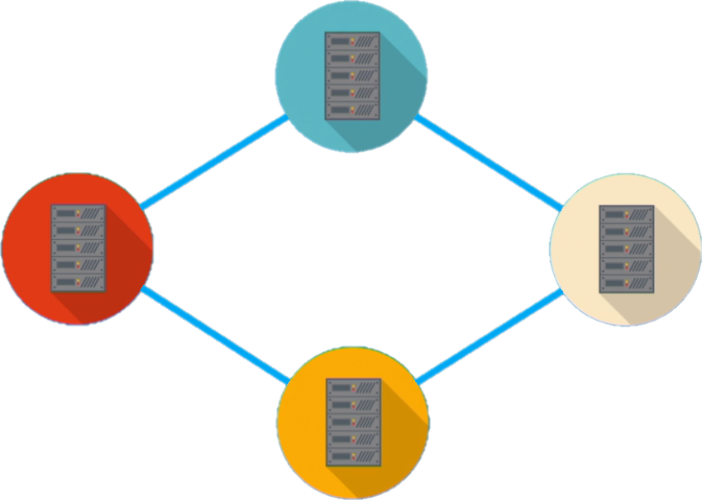
Traveling On the Packets in the Network

Slide 25
Internet Protocol
216.58.214.46
www.google.com
IPv4, IPv6 and DNS

Slide 26


Internet Protocol
One of the most important protocols used in Internet communication is the Internet Protocol (IP)
All the devices on the Internet have addresses
They are called IP Addresses
The IP address is unique to each computer or a device at the edge of the network
IP Address:
192.168.10.5
IP Address:
192.168.0.1

Slide 27
IPv4
IPv4 is a sequence of four, three-digit numbers separated by a period
Each number can be a number from 0 to 255
IPv4 is not enough for all network devices connected to the internet
In 1995, a new version of the internet protocol was created, it's called IPv6

Slide 28
IP Address
An IP Address has many parts, organized in a hierarchy
This version of IP Addressing is called IPv4
Provides more than 4 billion 32 bits unique addresses
Subnetworks
192.168.14.120
Device address

Slide 29
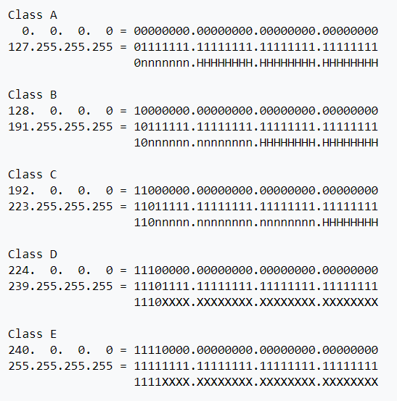
IP address classes

Slide 30
What Is CIDR (Classless Inter-Domain Routing)
Classless Inter-Domain Routing, is an IP addressing scheme that improves the allocation of IP addresses.
It replaces the old system based on classes A, B, and C.
This scheme also helped greatly extend the life of IPv4 as well as slow the growth of routing tables

Slide 31
IPv4 Private Address Space and Filtering
CIDR | IP address range | Class
10.0. 0.0/8 | 10.0. 0.0 – 10.255. 255.255 | A
172.16. 0.0/12 | 172.16. 0.0 – 172.31. 255.255 | B
192.168. 0.0/16 | 192.168. 0.0 – 192.168. 255.255 | C

Slide 32
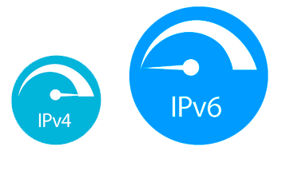
IPv6
IPV6 uses 128 bits - 340 undecillion unique addresses
That's more than the atoms on the surface of the Earth
These 128 bits are organized into eight 16 bit sections
Each 16 bit block is converted to hexadecimal and it's separated with a colon
This is a full IPV6 address:
3FFE:F200:0234:AB00:0123:4567:8901:ABCD
The leading zeros in IPv6 can usually be left out

Slide 33
What is a DNS?
www.softuni.bg
Domain name
The domain name is a human way to access IP addresses for devices and websites around the world
It is a sequence of phrases that map to a giant Internet-wide database of IP addresses
When a domain name is entered in the browser, a request is made to something called a DNS (Domain Name Server)
This server holds a cache of tons of domain names, and their matching IP addresses

Slide 34



DNS Example
request
IP Address | Domains
216.58.214.46 | Google.com
217.174.159.195 | Softuni.bg
https://softuni.bg
(217.174.159.195)
response

Slide 35
Reliability and TCP
TCP

Slide 36
Reliability
When packets are transmitted from one location to another, they can take different paths
When they get to the destination, they are unorganized and sometimes not complete
So the message needs to be audited and reviewed in order to put it together in the right way
The Transmission Control Protocol or TCP does exactly that

Slide 37

Transmission Control Protocol - TCP (1)
TCP uses a process, where it looks at all the packets in a message and checks them
Using the header information in each packet it knows:
How many there are
How large they should be
In which order the packets should be in
Using this checklist, it is able to rearrange the packets

Slide 38


Transmission Control Protocol - TCP (2)
If it finds that a packet doesn't match the expected characteristic, it is discarded
TCP has to verify that all the packets are:
In the right order
Free of any issues
After that it certifies the data and the packets are merged together to recreate the original file that was on the sender's device

Slide 39
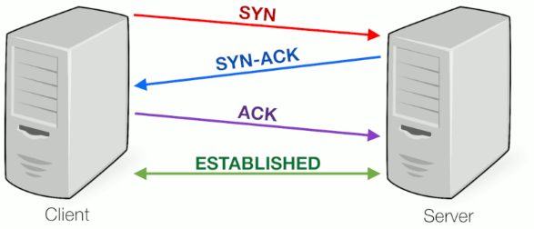
Transmission Control Protocol - TCP (3)

Slide 40
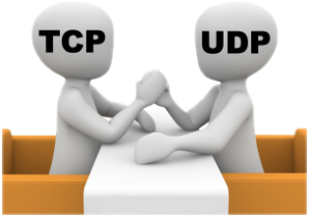
TCP vs UDP
TCP places reliability in a higher priority than speed or latency
For instances where reliability isn't as important, but speed is, there is another protocol called UDP or User Datagram Protocol
UDP doesn't do excessive reliability checks, but it can send information at a faster rate
TCP is the foundation of how a majority of data is transmitted over networks

Slide 41

User Datagram Protocol
UDP does not establish a session and it does not guarantee data delivery
It is known as the "fire-and-forget" protocol
It sends data and it doesn't really care if the data is received at the other end
Missing packets..
I don't care..
UDP

Slide 42
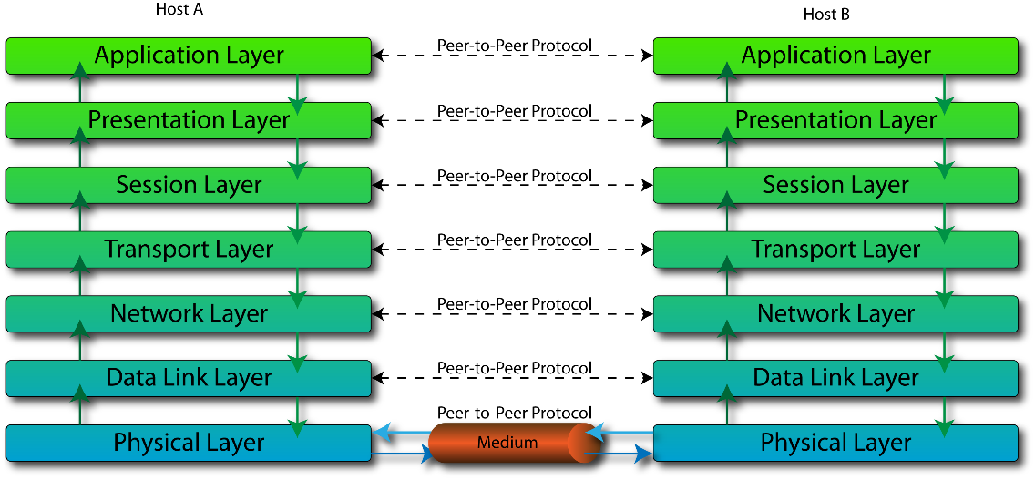
The OSI Model

Slide 43
What is the OSI Model?
OSI model stands for Open System Interconnect
It consists of 7 layers
Each layer serves the layer above it and in return, is served by the layer below it
Understanding each layer of the model helps us with:
Troubleshooting
Communicating better with technical and non-technical individuals about any system

Slide 44
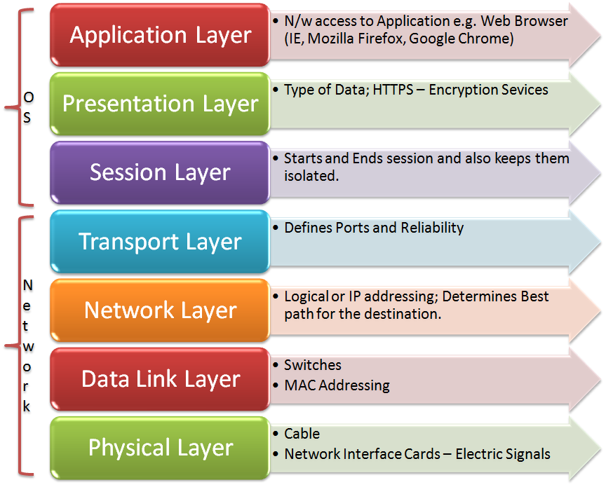
OSI Layers
OSI Model consists of 7 layers:
Example Protocols
HTTP, DNS, FTP, SMTP
TLS, SSL, compression
NetBIOS, PPTP, Sockets
TCP, UDP
IP, IPsec
ATM, Ethernet, MAC, LLC
USB, Bluetooth, 802.11a/b/g/n

Slide 45
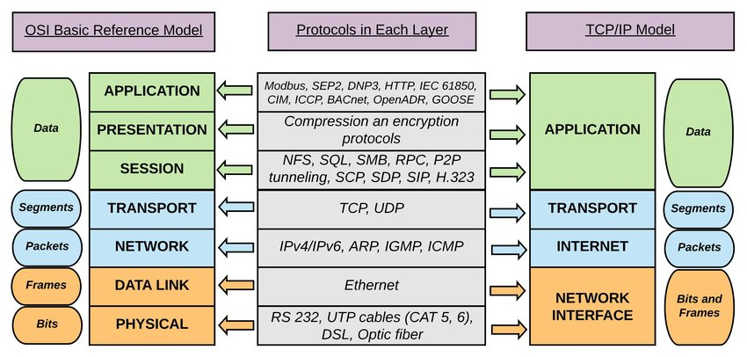
TCP/IP model mapping to OSI

Slide 46
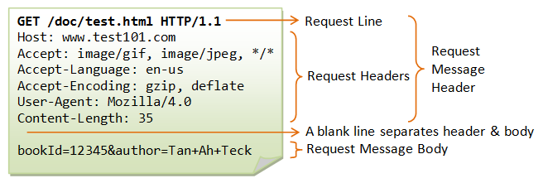
Application Layer – 7
Enables different applications like the browser to use the network and present it to the End User
Protocol examples:
Domain Name System (DNS)
File Transfer Protocol (FTP)
HyperText Transfer Protocol (HTTP)
Simple Mail Transfer Protocol (SMTP)

Slide 47
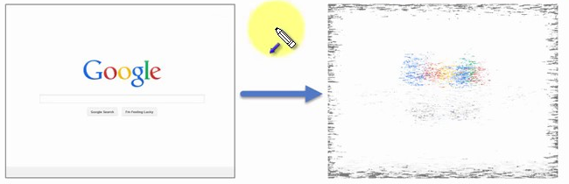
Presentation Layer – 6
This layer is a part of an operating system (OS)
Converts incoming and outgoing data from one presentation format to another
Example:
From clear text to encrypted (or compressed) text
Back to clear text

Slide 48
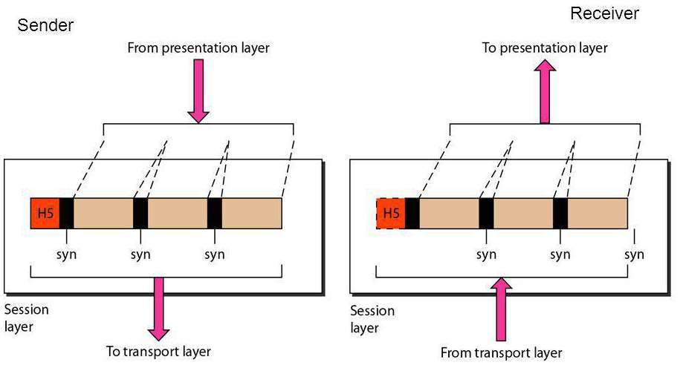
Session Layer – 5
This layer sets up coordinates and terminates conversations
Its services include authentication and reconnection after an interruption
e.g.: Sockets

Slide 49
Transport Layer – 4
Responsible for end-to-end communication over a network
Provides logical communication between application processes
Responsible for the management of error correction, providing quality and reliability to the end user
Protocol examples:
Transmission Control Protocol (TCP)
User Datagram Protocol (UDP)

Slide 50
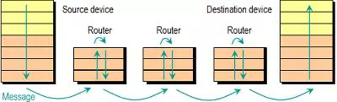
Network Layer – 3
Provides the functional and procedural means of transferring packets from one node to another
Responds to service requests from the transport layer and issues service requests to the data link layer
Protocol examples:
Internet Protocol (IP)
IPSec (IP + Auth)

Slide 51
Data Link Layer – 2 (1)
Provides node-to-node data transfer
It detects and possibly corrects errors that may occur in the physical layer
Divides into two sublayers:
Medium access control (MAC) layer - controlling how devices in a network gain access to a medium and permission to transmit data
Logical link control (LLC) layer – identifying and encapsulating network layer protocols, controls error checking and frame synchronization

Slide 52
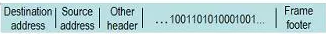
Data Link Layer – 2 (2)
Protocol examples:
Asynchronous Transfer Mode (ATM)
Ethernet
MAC

Slide 53
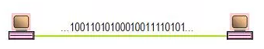
Physical Layer – 1
The things you can actually physically touch
Converts the binary from the upper layers into signals, transmits them over local media (electrical, light, or radio signals)
Examples:
Ethernet
USB
Bluetooth
802.11a/b/g/n

Slide 54
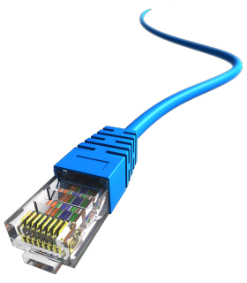
Network Hardware
Basic Hardware Components

Slide 55
Network Hardware
Basic Hardware Components
Cables
Routers
Repeaters, Hubs and Switches
Bridges
Gateways
Network Interface Cards

Slide 56
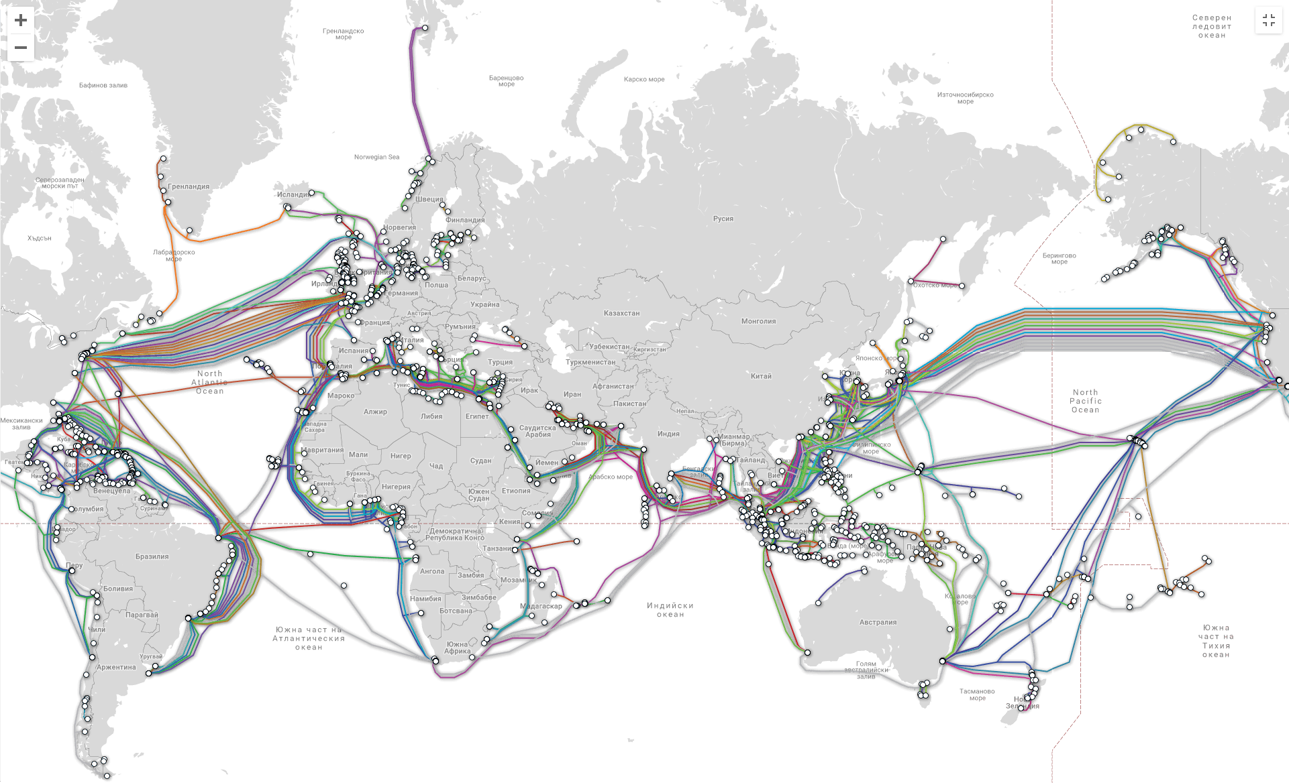
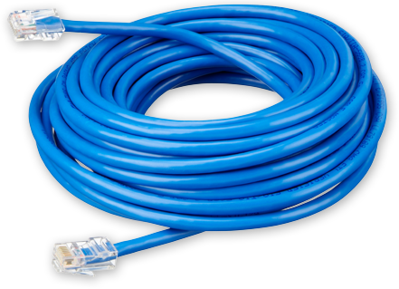
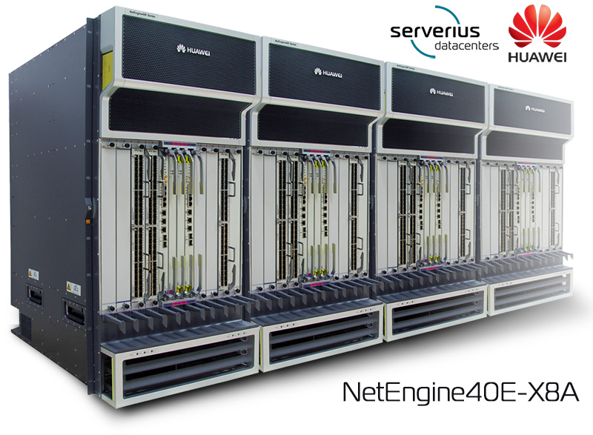
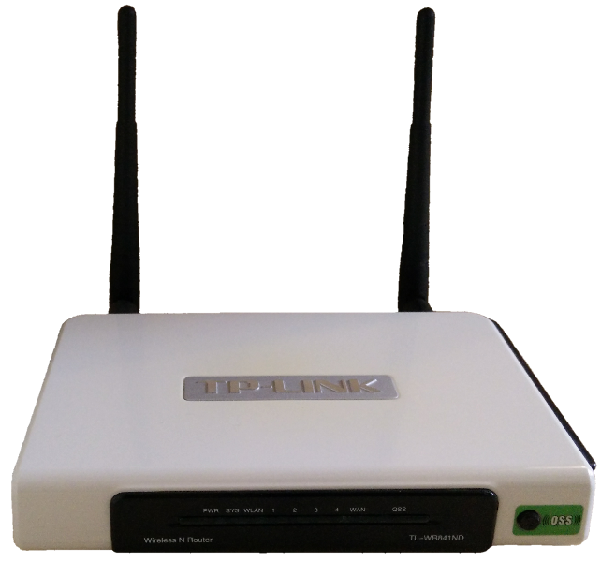
Cables and Routers
Network Cables – the transmission media to transfer data from one device to another
Router – connecting device that transfers data packets between different computer networks (operates on level 3 of OSI)

Slide 57
Repeaters, Hubs and Switches
Repeaters, hubs and switches connect network devices together so that they can function as a single segment
Repeater – receives a signal and regenerates it before re-transmitting, so that it can travel longer distances
Hub – multiport repeater (operates on level 1 of the OSI model)
Switch – receives data from a port, uses packet switching to resolve the destination device and forwards the data to the particular destination (operates on level 2 of the OSI model)

Slide 58
Bridges and Gateways
Bridge
Connects two separate but similar Ethernet network segments
Forwards packets from the source network to the destined network (operates on level 2 of OSI)
Gateway
Connects networks that work upon different protocols
The entry and the exit point of a network (controls the access to other networks)
Level 4, 5, 6 or 7 of the OSI model (same as Firewalls)

Slide 59
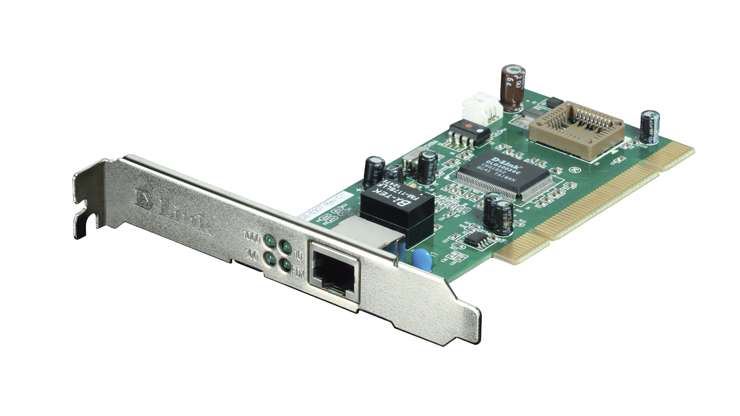
Network Interface Cards – NIC
NIC – a computer component that connects it to the network
There are two types of network cards:
Internal
External

Slide 60

The Future of the Internet

Slide 61
The Future of the Internet
A typical modern home consists of: PC, Laptop, Tablet, Phones, TV, Security Camera, Air Conditioner, Smart Watch, Printer, Music Player, Light, etc.
The "Internet of Things" will expand
Healthcare, agriculture, wearables, manufacturing
Smart homes, cars and cities (pollution, parking, energy)
In 2030 there will be 50 billion devices connected to the Internet of Things

Slide 62

HTTP Protocol​
Handling Requests, ​ Constructing Responses, HTTP/2
SoftUni Team
Technical Trainers
Software University
https://softuni.bg

Slide 63
Table of Content
Http Basics
URL
Http Request
Http Response
MIME and Media types
HTTP Tools
Web Server
Html Forms
Http/2

Slide 64
Questions?
sli.do
#java-web

Slide 65

HTTP Basics​
Request and Responses

Slide 66


Hyper Text Transfer Protocol
Request
Response
HTTP
HTTP
TCP
TCP
IP
IP
Media (wires / air / fiber)
Ethernet
Ethernet
Notes:
HTTP == Hyper Text Transfer Protocol
Client-server protocol for transferring Web resources (HTML files, images, styles, scripts, data, etc.)
The widespread protocol for Internet communication today
Request-response model (client requests, server answers)
Text-based format (human readable)
Relies on unique resource URLs
Provides resource metadata (e.g. encoding)
Stateless (cookies and Web storages can overcome this)

Slide 67
HTTP Request Methods
HTTP defines methods to indicate the desired action to be performed on the identified resource
Method | Description
GET | Retrieve / load a resource
POST | Create / store a resource
PUT | Update a resource
DELETE | Remove a resource

Slide 68
HTTP Conversation: Example
GET /courses/javascript HTTP/1.1
Host: www.softuni.bg
User-Agent: Mozilla/5.0
<CRLF>
HTTP request:
HTTP response:
The empty line denotes the end of the request header
HTTP/1.1 200 OK
Date: Mon, 5 Jul 2020 13:09:03 GMT
Server: Microsoft-HTTPAPI/2.0
Last-Modified: Mon, 12 Jul 2014 15:33:23 GMT
Content-Length: 54
<CRLF>
<html><title>Hello</title>
Welcome to our site</html>
The empty line denotes the end of the response header

Slide 69

URL
Uniform Resource Locator

Slide 70
Uniform Resource Locator (URL)
http://localhost:8080/demo/index.html?id=27&lang=en#lecture
Protocol
Host
Port
Path
Query String
Fragment
URL is a formatted string, consisting of:
Protocol for communicating (http, ftp, https...) – HTTP in most cases
Host or IP address (www.softuni.bg, gmail.com, 127.0.0.1, web)
Port (the default port is 80) – a number in range [0…65535]
Path (/forum, /path/index.html)
Query string (?id=27&lang=en)
Fragment (#lectures) – used on the client to navigate to some section

Slide 71
URL Encoding
URLs are encoded according RFC 1738:
Safe URL characters: [0-9a-zA-Z], $, -, _, . , +, *, ', (, ), ,, !
All other characters are escaped by:
Space is encoded as "+" or "%20"
URL-encoded string:
Char | URL Encoding
space | %20
щ | %D1%89
" | %22
# | %23
$ | %24
% | %25
& | %26
%[character hex code]
Наков-爱-SoftUni
%D0%9D%D0%B0%D0%BA%D0%BE%D0%B2-%E7%88%B1-SoftUni

Slide 72
Valid and Invalid URLs – Examples
Some valid URLs:
Some invalid URLs:
http://www.google.bg/search?sourceid=navclient&ie=UTF-8&rlz=1T4GGLL_enBG369BG369&q=http+get+vs+post
http://bg.wikipedia.org/wiki/%D0%A1%D0%BE%D1%84%D1%82%D1%83%D0%B5%D1%80%D0%BD%D0%B0_%D0%B0%D0%BA%D0%B0%D0%B4%D0%B5%D0%BC%D0%B8%D1%8F
Should be: ?q=C%23+.NET+4.0
http://www.google.bg/search?&q=C# .NET 4.0
Should be: ?q=%D0%B1 %D0%B8%D1%80%D0%B0
http://www.google.bg/search?&q=бира

Slide 73

HTTP Request​
What is a HTTP Request?

Slide 74
HTTP Request Message
Request message sent by a client consists of:
HTTP request line
Request method (GET / POST / PUT / DELETE / …)
Resource URI (URL)
Protocol version
HTTP request headers
Additional parameters
HTTP request body – optional data, e.g. posted form fields
<method> <resource> HTTP/<version>
<headers>
(empty line)
<body>

Slide 75
HTTP GET Request – Example
Example of HTTP GET request:
GET /index.html HTTP/1.1
Host: localhost
<CRLF>
HTTP request line
HTTP request headers
The request body is empty

Slide 76
HTTP POST Request – Example
Example of HTTP POST request:
POST /login.html HTTP/1.1
Host: localhost
Content-Length: 59
Content-Type: application/x-www-form-urlencoded
<CRLF>
username=testUser&password=topSecret
<CRLF>
HTTP request line
HTTP request headers
The request body holds the submitted form data

Slide 77

HTTP Response​
What is a HTTP Response?

Slide 78
HTTP Response Message
The response message sent by the HTTP server consists of:
HTTP response status line
Protocol version
Status code
Status phrase
Response headers
Provide meta data about the returned resource
Response body
The content of the HTTP response (data)
HTTP/<version> <status code> <status text>
<headers>
(empty line)
<response body – the requested resource>

Slide 79
HTTP Response – Example
Example of HTTP response from the Web server:
HTTP response status line
HTTP/1.1 200 OK
Date: Fri, 17 Jul 2020 16:09:18 GMT+2
Server: Apache/2.2.14 (Linux)
Accept-Ranges: bytes
Content-Length: 84
Content-Type: text/html
<CRLF>
<html>
<head><title>Test</title></head>
<body>Test HTML page.</body>
</html>
HTTP response headers
HTTP response body

Slide 80
HTTP Response Codes
HTTP response code classes
1xx: informational (e.g., "100 Continue")
2xx: successful (e.g., "200 OK", "201 Created")
3xx: redirection (e.g., "304 Not Modified", "301 Moved Permanently", "302 Found")
4xx: client error (e.g., "400 Bad Request", "404 Not Found", "401 Unauthorized", "409 Conflict")
5xx: server error (e.g., "500 Internal Server Error", "503 Service Unavailable")

Slide 81
HTTP Error Response – Example
Example of HTTP response with error result:
HTTP response status line
HTTP/1.1 404 Not Found
Date: Fri, 17 Nov 2020 16:09:18 GMT+2
Server: Apache/2.2.14 (Linux)
Connection: close
Content-Type: text/html
<CRLF>
<html><head><title>404 Not Found</title></head>
<body>
<h1>Not Found</h1>
<p>The requested URL /img/logo.gif was not found on this server.</p> <hr><address>Apache/2.2.14 Server at Port 80</address>
</body></html>
HTTP response headers
The HTTP response body

Slide 82
Browser Redirection
HTTP GET requesting a moved URL:
The following HTTP response (301 Moved Permanently) tells the browser to request another URL:
GET / HTTP/1.1
Host: http://softuni.org
User-Agent: Gecko/20100115 Firefox/3.6
<CRLF>
HTTP/1.1 301 Moved Permanently
Location: http://softuni.bg
…

Slide 83
Content-Type and Disposition
The Content-Type response header the server specifies how the output should be processed
Examples:
UTF-8 encoded HTML page. Will be shown in the browser.
Content-Type: text/html; charset=utf-8
Content-Type: application/pdf
Content-Disposition: attachment; filename="Report-April-2020.pdf"
This will download a PDF file named Report-April-2020.pdf

Slide 84

MIME and Media Types
Multi-Purpose Internet Mail Extensions

Slide 85
What is MIME?
MIME == Multi-Purpose Internet Mail Extensions
Internet standard for encoding resources
Originally developed for email attachments
Used in many Internet protocols like HTTP and SMTP
MIME defines several concepts
Content-Type, e.g. text/html, image/gif, application/pdf
Content charset, e.g. utf-8, ascii, windows-1251
Content-Disposition, e.g. attachment; filename=logo.jpg
Multipart messages (multiple resources in a single document)

Slide 86
Common MIME Media Types
MIME Type / Subtype | Description
application/json | JSON data
image/png | PNG image
image/gif | GIF image
text/html | HTML
text/plain | Text
text/xml | XML
video/mp4 | MP4 video
application/pdf | PDF document

Slide 87

HTTP Tools
Tools for Developers

Slide 88
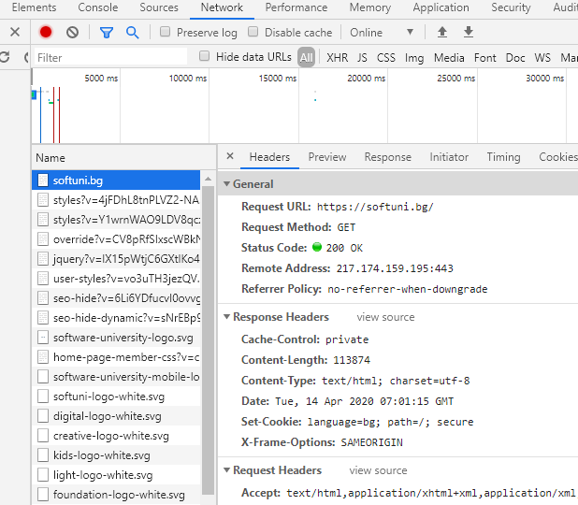
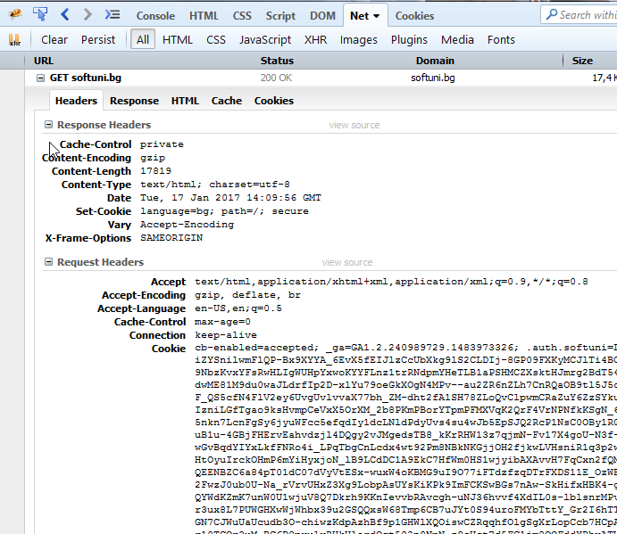
HTTP Tools for Developers – Browser (1)
Chrome Developer Tools
Firebug

Slide 89



HTTP Tools for Developers – Browser (2)
Insomnia Rest
Postman
RESTClient

Slide 90
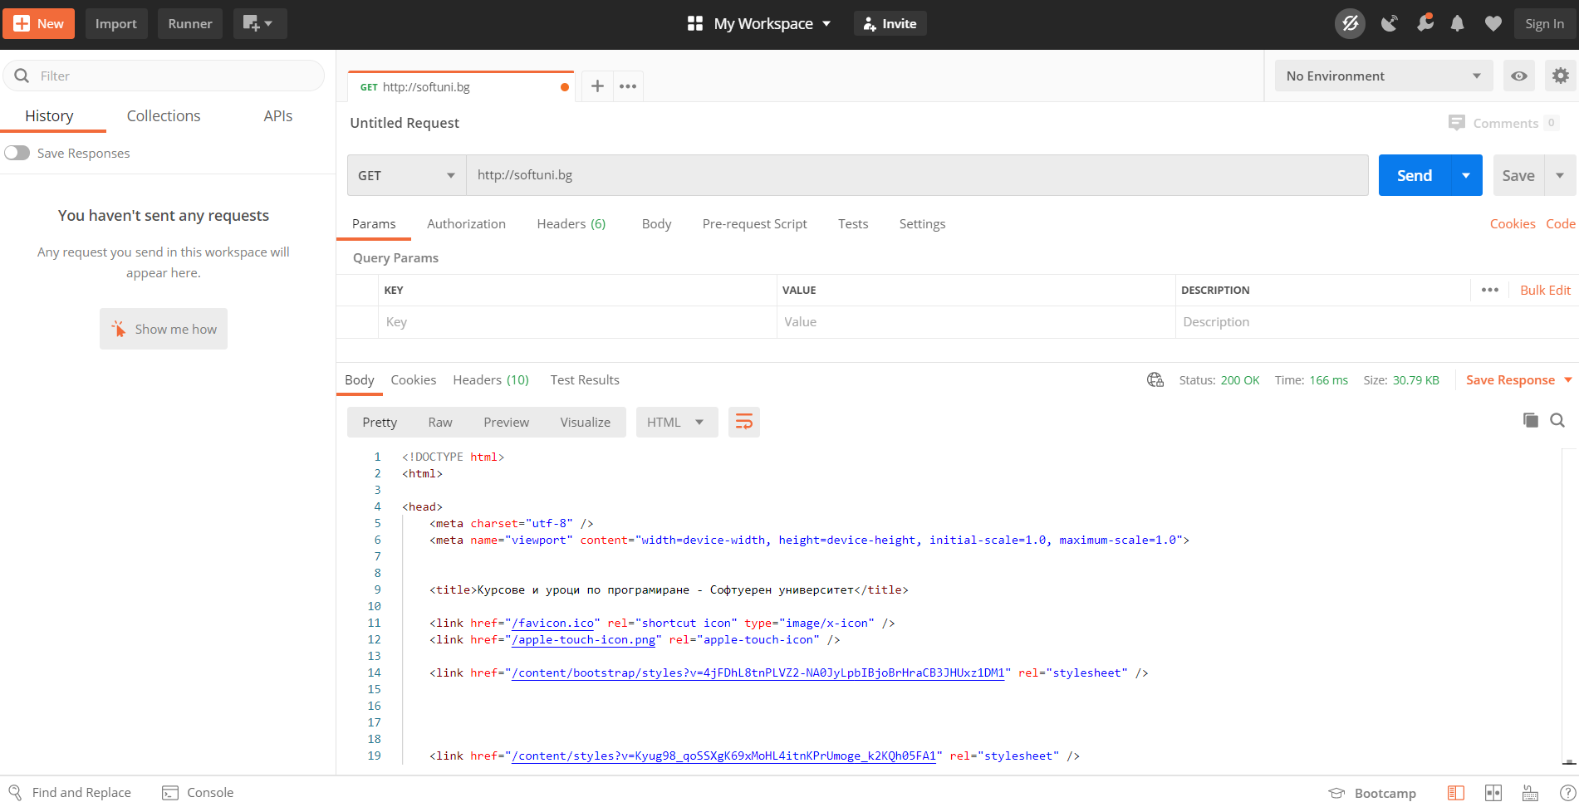
HTTP Tools for Developers – Postman
Postman

Slide 91
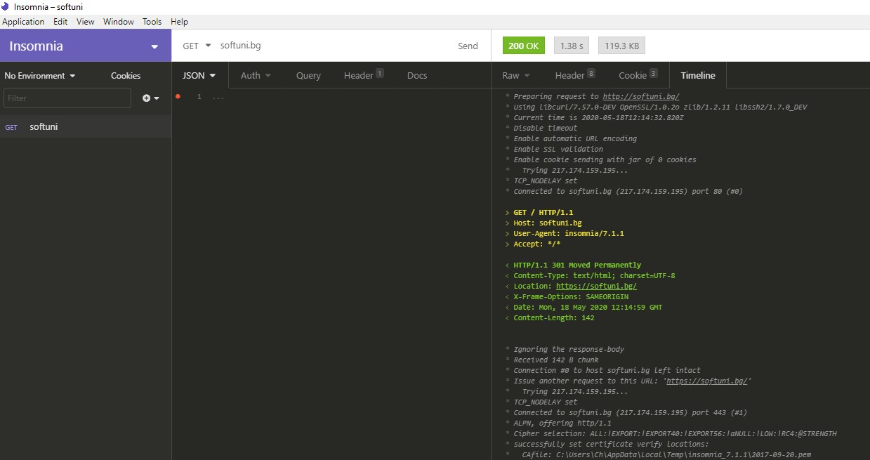
HTTP Tools for Developers – Insomnia
Insomnia Rest

Slide 92



Web Server

Slide 93
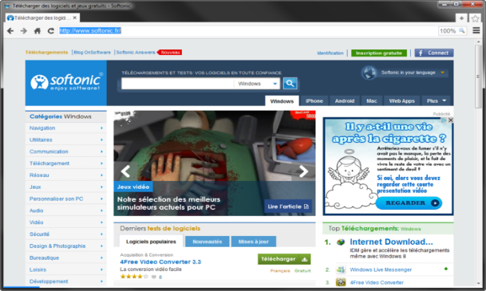

What is a Web Server?
Computer system that processes requests via HTTP, the basic network protocol
Web Client
Web Server
Communication

Slide 94

Web Server Work Model (1)
Web Server
Web Resources
Web Client
Request
Protocol
Response
HTML, PDF, JPG…
Protocols:
HTTP FTP WebSocket
Protocol
Host
Port
Resource
URL
http://localhost:8000/softuni.jpg

Slide 95
Web Server Work Model (2)
Web Server
Technology
Web Client
Request
Protocol
Response
Web Resources
Database
HTML, PDF, JPG…

Slide 96


Web Server Work Model (3)
Web Server
Technology
Spring
Web Resources
Database
HTML, PDF, JPG…

Slide 97
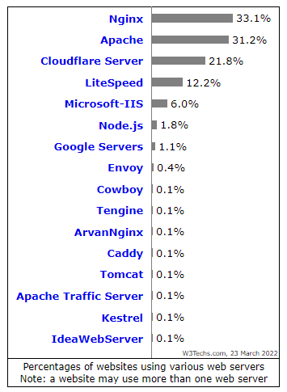

Most Popular Web Servers (W3Techs)

Slide 98
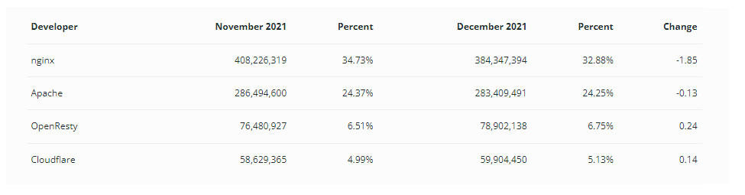
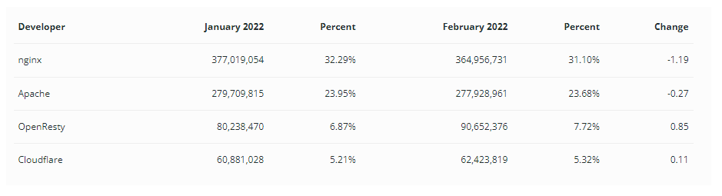
Most Popular Web Servers (NetCraft)

Slide 99



HTML Forms
Form Method and Action

Slide 100
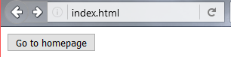

HTML Forms – Action Attribute
Defines where to submit the form data:
<form action="home.html">
<input type="submit" value="Go to homepage"/>
</form>

Slide 101


HTML Forms – Method Attribute (1)
Specifies the HTTP method to use when sending form-data
<form action="/" method="get"> Name: <input type="text" name="name"> <br>
<input type="submit" value="Submit">
</form>
The form data is in the URL

Slide 102
HTML Forms – Method Attribute (2)
<form action="/" method="post"> Name: <input type="text" name="name"> <br>
<input type="submit" value="Submit">
</form>
POST http://localhost/index.html HTTP/1.1
Host: localhost
Content-Type: application/x-www-form-urlencoded
Content-Length: 10
name=Pesho
HTTP request body holds the form data

Slide 103

URL Encoded Form Data – Example
<form action="/" method="post">
Name: <input type="text" name="name"/> <br/>
Age: <input type="text" name="age"/> <br/>
<input type="submit" />
</form>
POST http://localhost/cgi-bin/index.cgi HTTP/1.1
Host: localhost
Content-Type: application/x-www-form-urlencoded
Content-Length: 23
name=Maria+Smith&age=19
File uploads are not supported

Slide 104

HTTP/2
What's New? What's Better? What's HTTP/2

Slide 105

What's HTTP/2
HTTP/2 (originally named HTTP/2.0) major revision of the HTTP network protocol used by the World Wide Web.
Supported by most of the popular web browsers (Chrome, Mozilla, Opera...)
Fast & Optimized. Meets modern web usage requirements.
Completely Backwards-Compatible.
As of Jan 2021, 50% of all the websites support HTTP/2 (W3Techs statistics).

Slide 106


What's New?
HTTP/2 is meant to erase the need of maintaining complex server infrastructures in order to perform well.
HTTP/2 communicates in binary data frames.
HTTP/2 introduces several new important elements
HTTP/2 Multiplexing
HTTP/2 Header Compression
HTTP/2 Server Push

Slide 107

HTTP/2 Multiplexing
The art of handling multiple streams over a single TCP connection.

Slide 108

HTTP/2
HTTP/2 maintains a HTTP Header Table across requests.
Optimizes communication drastically.
The process is essentially a de-duplication, rather than compression.
HTTP/2

Slide 109

HTTP/2 Server Push
HTTP/2 Server Push is the process of sending resources to clients, without them having to ask for it.

Slide 110

What's HTTP/3
HTTP/3 is a new standard in development that will affect how web browsers and servers communicate.
Significant upgrades for user experience
Performance, Reliability, and Security
HTTP/3 runs on QUIC, a new transport protocol designed for mobile-heavy Internet usage.

Slide 111

Spring Fundamentals
Spring Boot Introduction
SoftUni Team
Technical Trainers
Software University
https://softuni.bg

Slide 112
Table of Contents
What's Spring Boot?
Spring Data

Slide 113
Questions
sli.do #java-web

Slide 114

What is Spring Boot?

Slide 115





Spring Boot
Opinionated view of building production-ready Spring applications
Tomcat
pom.xml
Gradle
Spring Boot
Auto configuration

Slide 116

Creating Spring Boot Project
Just go to https://start.spring.io/

Slide 117
Spring Dev Tools
Additional set of tools that can make the application development faster and more enjoyable
In Maven:
In Gradle:
pom.xml
<dependency> <groupId>org.springframework.boot</groupId> <artifactId>spring-boot-devtools</artifactId> <scope>runtime</scope> </dependency>
build.gradle
dependencies {
compileOnly("org.springframework.boot:spring-boot-devtools")
}

Slide 118

Spring Resources
HTML, CSS, JS
Thymeleaf templates
Yaml configuration

Slide 119
Spring Boot Main Components
Some main components:
Spring Boot Starters - combine a group of common or related dependencies into single dependency
Spring Boot Auto-Configuration - reduce the Spring Configuration
Spring Boot Actuator – provides EndPoints and Metrics
Spring Data – unify and ease the access to
different kinds of database systems

Slide 120
Spring Boot Starters
spring-boot-starter-web
spring-boot-starter-tomcat
spring-web
spring-data
…
tomcat-embed-core​
…
spring-webmvc
…
spring-jpa
…
spring-aop
spring-beans
spring-context
spring-core
…

Slide 121

Spring Boot CLI
Command Line Interface - Spring Boot software to run and test Spring Boot applications

Slide 122

Spring Boot Actuator
Expose different types of information about the running application
build.gradle
dependencies {
compileOnly("org.springframework.boot:spring-boot-starter-actuator")
}

Slide 123
Inversion of Control
Spring provides Inversion of Control and Dependency Injection
UserServiceImpl.java
UserServiceImpl.java
//Traditional Way
public class UserServiceImpl implements UserService {
private UserRepository userRepository = new UserRepositoryImpl();
}
//Dependency Injection
@Service
public class UserServiceImpl implements UserService {
@Autowired
private UserRepository userRepository;
}

Slide 124
Spring IoC
Meta Data:
XML Config
Java Config
Automatic Beans:
@Component
@Service
@Repository
Explicit Beans
1. @Bean
Configuration
IoC
Fully Configured System

Slide 125
Beans
Object that is instantiated, assembled, and otherwise managed by a Spring IoC container
Dog.java
public class Dog implements Animal {
private String name;
public Dog() {}
//GETTERS AND SETTERS
}

Slide 126
Bean Declaration
MainApplication.java
@SpringBootApplication
public class MainApplication {
…
@Bean
public Animal getDog(){
return new Dog();
}
}
Bean Declaration

Slide 127

Get Bean from Application Context
MainApplication.java
@SpringBootApplication
public class MainApplication {
public static void main(String[] args) {
ApplicationContext context = SpringApplication.run(MainApplication.class, args);
Animal dog = context.getBean(Dog.class);
System.out.println("DOG: " + dog.getClass().getSimpleName());
}
}

Slide 128
Beans Scopes in Spring Framework
There are part of Beans scopes:
Singleton
Prototype
Request
Session

Slide 129
Singletone Scope
Container creates a single instance of that bean, and all requests for that bean name will return the same object, which is cached
This is default scope
@Bean
@Scope("singleton") <- Can be omitted
public Student student() {
return new Student();
}

Slide 130
Prototype Scope
Will return a different instance every time it is requested from the container
@Bean
@Scope("prototype")
public Student student() {
return new Student();
}

Slide 131
Bean Scope
The default one is Singleton. It is easy to change to Prototype
Mostly used as State-less
Mostly used as State-full
Singleton
Prototype
Request A
Request A
Animal 1
Request B
Animal
Request B
Animal 2
Request C
Request C
Animal 3

Slide 132
Bean Lifecycle
Instantiation
Set Properties
Set Name
Initialization
Pre Initialization
Set Application Context
Container Shutdown
Post Initialization
Bean is ready
Bean is destroyed

Slide 133
Bean Lifecycle Demo (1)
MainApplication.java
@SpringBootApplication
public class MainApplication {
public static void main(String[] args) {
ApplicationContext context = SpringApplication.run(MainApplication.class, args);
((AbstractApplicationContext)context).close();
}
@Bean(destroyMethod = "destroy", initMethod = "init")
public Animal getDog(){
return new Dog();
}
}

Slide 134

Bean Lifecycle Demo (2)
MainApplication.java
public class Dog implements Animal {
public Dog() {
System.out.println("Instantiation");
}
public void init(){
System.out.println("Initializing..");
}
public void destroy(){
System.out.println("Destroying..");
}
}

Slide 135
PostConstruct Annotation
Spring calls methods annotated with @PostConstruct only once, just after the initialization of bean
@Component
public class DbInit {
private final UserRepository userRepository;
public DbUnit(UserRepository userRepository)
{ this. userRepository = userRepository;}
@PostConstruct
private void postConstruct() {
User admin = new User("admin", "admin password");
User normalUser = new User("user", "user password");
userRepository.save(admin, normalUser);
}
}

Slide 136
PreDestroy Annotation
A method annotated with @PreDestroy runs only once, just before Spring removes our bean from the application context
@Component
public class UserRepository {
private DbConnection dbConnection;
@PreDestroy
public void preDestroy() {
dbConnection.close();
}
}

Slide 137
BeanNameAware Interface
BeanNameAware makes the object aware of the bean name defined in the container
public class MyBeanName implements BeanNameAware {
@Override
public void setBeanName(String beanName) {
System.out.println(beanName);
}
}
@Configuration
public class Config {
@Bean (name = "myCustomBeanName")
public MyBeanName getMyBeanName() {
return new MyBeanName();
}
}

Slide 138
BeanFactoryAware Interface
BeanFactoryAware is used to inject the BeanFactory object
With the setBeanFactory() method, we assign the BeanFactory reference from the IoC container to the beanFactory property
public class MyBeanFactory implements BeanFactoryAware {
private BeanFactory beanFactory;
@Override
public void setBeanFactory(BeanFactory beanFactory)throws BeansException {
this.beanFactory = beanFactory;}
public void getMyBeanName() {
MyBeanName myBeanName = beanFactory.getBean(MyBeanName.class);
System.out.println(beanFactory.isSingleton("myCustomBeanName"));
}
}

Slide 139
InitializingBean Interface
For bean implemented InitializingBean, it will run afterPropertiesSet() after all bean properties have been set
@Component
public class InitializingBeanExampleBean implements InitializingBean {
private static final Logger LOG
= Logger.getLogger(InitializingBeanExampleBean.class);
@Autowired
private Environment environment;
@Override
public void afterPropertiesSet() throws Exception {
LOG.info(Arrays.asList(environment.getDefaultProfiles()));
}
}

Slide 140
DisposableBean Interface
For bean implemented DisposableBean, it will run destroy() after Spring container is released the bean
@Component
public class Bean2 implements DisposableBean {
@Override
public void destroy() throws Exception {
System.out.println(
"Callback triggered - DisposableBean.");
}
}

Slide 141
Common Application Properties
Various properties can be specified inside your application.yaml file
Property contributions can come from additional jar files
You can define your own properties
Link to documentation

Slide 142
Application Properties Example
application.properties
spring.datasource.driverClassName=com.mysql.cj.jdbc.Driver
spring.datasource.url=jdbc:mysql://localhost:3306/thymeleaf_adv_lab_exam_db?createDatabaseIfNotExist=true
spring.datasource.username=root
spring.datasource.password=12345
spring.jpa.properties.hibernate.dialect = org.hibernate.dialect.MySQL8Dialect
spring.jpa.properties.hibernate.format_sql = TRUE
spring.jpa.hibernate.ddl-auto = update
spring.jpa.open-in-view=false
logging.level.org = WARN
logging.level.blog = WARN
logging.level.org.hibernate.SQL = DEBUG
logging.level.org.hibernate.type.descriptor = TRACE
server.port=8000

Slide 143
Application Yaml Example
application.yaml
spring:
datasource:
driverClassName: com.mysql.cj.jdbc.Driver
password: 12345
url: jdbc:mysql://localhost:3306/spring_data_lab_db?allowPublicKeyRetrieval=true&useSSL=false&createDatabaseIfNotExist=true
username: root
jpa:
database-platform: org.hibernate.dialect.MySQL8Dialect
hibernate:
ddl-auto: create-drop
open-in-view: false
properties:
hibernate:
format_sql: true

Slide 144

Spring Data

Slide 145
Overall Architecture
Repository
Service
Controller
Database
View
Entities
Models/ DTO
Back-End

Slide 146
Entities
Entity is a lightweight persistence domain object
Cat.java
@Entity
@Table(name = "cats")
public class Cat {
@Id
@GeneratedValue(strategy = GenerationType.IDENTITY)
private long id;
private String name;
//GETTERS AND SETTERS
}

Slide 147
Repositories
Persistence layer that works with entities
CatRepository.java
@Repository
public interface CatRepository extends JpaRepository<Cat, Long> {
}

Slide 148
Services
Business Layer - All the business logic is here.
CatService.java
@Service
public class CatServiceImpl implements CatService {
private final CatRepository catRepository;
@Autowired
public CatServiceImpl(CatRepository catRepository){
this.catRepository = catRepository;
}
@Override
public void buyCat(CatModel catModel) { //TODO Implement the method }
}

Slide 149

Spring Introduction MVC
Spring Fundamentals
SoftUni Team
Technical Trainers
Software University
https://softuni.bg

Slide 150
Table of Content
What is Spring MVC
Spring Controllers
Inversion of Control
Layers – dividing code
Thin Controllers

Slide 151
Questions
sli.do #java-web

Slide 152
What is Spring MVC?

Slide 153
What is Spring MVC?
Model-view-controller (MVC) framework is designed around a DispatcherServlet that dispatches requests to handlers
Find Controller
Handler
Mapping
Controller
Service
Request
Execute
Action
Dispatcher Servlet
Handler
Adapter
View Name
Repository
View
Resolver
Result Model
Resolve View
DB
Response
View
Result Model
Model
Business Logic
Notes:
Blue Color – Provided by Spring Purple Color – To Be Implemented by the Developer Green Color – Provided by Spring. Sometimes implemented by the developer

Slide 154
MVC – Control Flow
Web Client
Request
Controller
Response (html, json, xml)
Create Model
User Action
Update View
Model
View

Slide 155

Spring Controllers
Annotations, IoC Container

Slide 156
Spring Controllers
Defined with the @Controller annotation
Controllers can contain multiple actions on different routes
@Controller
public class HomeController {
...
}

Slide 157
Request Mapping (1)
Annotated with @RequestMapping(…)
Or
@RequestMapping("/home")
public String home(Model model) {
model.addAttribute("message", “Welcome!");
return "home-view";
}
@RequestMapping("/home")
public ModelAndView home(ModelAndView mav) {
mav.addObject("message", “Welcome!");
mav.setViewName("home-view");
return mav;
}

Slide 158
Request Mapping (2)
Problem when using @RequestMapping is that it accepts all types of request methods (get, post, put, delete, head, patch)
Execute only on GET requests
@RequestMapping(value="/home", method=RequestMethod.GET)
public String home() {
return "home-view";
}

Slide 159
Get Mapping
Easier way to create route for a GET request
This is alias for RequestMapping with method GET
@GetMapping("/home")
public String home() {
return "home-view";
}

Slide 160

Actions – Get Requests
Controller
CatController.java
@Controller
public class CatController {
@GetMapping("/cat")
public String getHomeCatPage(){
return "cat-page.html";
}
}
Request Mapping
Action
View

Slide 161
Controllers
Controller
DogController.java
@Controller
public class DogController {
@GetMapping("/dog")
@ResponseBody
public Dog getDogHomePage(){
Dog dog = dogService.getBestDog();
return dog;
}
}
Request Mapping
Action

Slide 162
Post Mapping
Similar to the GetMapping there is also an alias for RequestMapping with method POST
Similar annotations exist for all other types of request methods
@PostMapping("/register")
public String register(UserDTO userDto) {
…
}

Slide 163

Actions – Post Requests (1)
CatController.java
@Controller
@RequestMapping("/cat")
public class CatController {
@GetMapping("")
public String addCat(){
return "new-cat.html";
}
}
Starting route

Slide 164

Actions – Post Requests (2)
CatController.java
@Controller
@RequestMapping("/cat")
public class CatController {
@PostMapping("")
public String addCatConfirm(@RequestParam String catName, @RequestParam int catAge){
System.out.println(String.format( "Cat Name: %s, Cat Age: %d", catName, catAge));
return "redirect:/cat";
}
}
Request param
Redirect

Slide 165
Passing Attributes to View (1)
Passing a String to the view
The Model object will be automatically passed to the view as context variables
Attributes can be accessed from Thymeleaf
@GetMapping("/")
public String welcome(Model model) {
model.addAttribute("name", "Pesho");
return "index";
}

Slide 166
Passing Attributes to View (2)
Passing a ModelMap object to the view
The ModelMap object will be automatically passed to the view as context variables
Attributes can be accessed from Thymeleaf
@GetMapping("/")
public String welcome(ModelMap modelMap) {
modelMap.addAttribute("name", "Pesho");
return "index";
}

Slide 167
Passing Attributes to View (3)
Passing a ModelAndView object to the view
The ModelAndView object will be automatically passed to the view as context variables
Attributes can be accessed from Thymeleaf
@GetMapping("/")
public ModelAndView welcome(ModelAndView model) {
model.addObject("name", "Pesho");
model.setViewName("index")
return model;
}

Slide 168

Models and Views
DogController.java
@Controller
public class DogController {
@GetMapping("/dog")
public ModelAndView getDogHomePage(ModelAndView modelAndView){
modelAndView.setViewName("dog-page.html");
return modelAndView;
}
}
Model and View

Slide 169
Request Parameters
Getting a parameter from the query string
@RequestParam can also be used to get POST parameters
@GetMapping("/details")
public String details(@RequestParam("id") Long id) {
...
}
@PostMapping("/register")
public String register(@RequestParam("name") String name) {
...
}

Slide 170
Request Parameters with Default Value
Getting a parameter from the query string
Making parameter optional
@GetMapping("/comment")
public String comment(@RequestParam(name="author", defaultValue = "Annonymous") String author) {
...
}
@GetMapping("/search")
public String search(@RequestParam(name="sort",
required = false) String sort) {
...
}

Slide 171
Path Variable
Getting a parameter from the query string
@GetMapping("/details/{id}")
public String details(@PathVariable("id") Long id) {
...
}

Slide 172
Form Objects
Spring will automatically try to fill objects with a form data
The input field names must be the same as the object field names
@PostMapping("/register")
public String register(UserDTO userDto) {
...
}

Slide 173
Redirecting
Redirecting after POST request
@PostMapping("/register")
public String register(UserDTO userDto) {
...
return "redirect:/login";
}

Slide 174
Redirecting with Parameters
Redirecting with query string parameters
@PostMapping("/register")
public String register(UserDTO userDto,
RedirectAttributes redirectAttributes) {
redirectAttributes.addAttribute("errorId", 3);
return "redirect:/login";
}

Slide 175
Redirecting with Attributes
Keeping objects after redirect
@PostMapping("/register")
public String register(@ModelAttribute UserDTO userDto,
RedirectAttributes redirectAttributes) {
...
redirectAttributes.addFlashAttribute("userDto", userDto);
return "redirect:/register";
}

Slide 176

Inversion of Control
Constructor vs Field vs Setter Injection

Slide 177

Field Injection
Easy to write
Easy to add new dependencies
It hides potential architectural problems!
@Autowired
private ServiceA serviceA
@Autowired
private ServiceB serviceB
@Autowired
private ServiceC serviceC

Slide 178

Constructor Injection
Time Consuming
Harder to add dependencies
It shows potential architectural problems!
@Autowired
public ControllerA(ServiceA serviceA, ServiceB serviceB, ServiceC serviceC) {
this.serviceA = serviceA;
this.serviceB = serviceB;
this.serviceC = serviceC;
}

Slide 179
Setter Injection
Create setters for dependencies
Can be combined easily with constructor injection
Flexibility in dependency resolution or object reconfiguration!
@Service
public class HomeContoller(){
//...
@Autowired
public void setServiceA(ServiceA serviceA) {
this.serviceA = serviceA;
}
}

Slide 180

Layers
The Correct Project Structure

Slide 181



Layers (1)
We are used to splitting our code based on its functionality:
It gets hard to navigate in bigger applications

Slide 182



Layers (2)
Splitting the project into different modules
Each module corresponding to the application layer
Makes it easier to navigate

Slide 183

Thin Controllers
Creating Simple Components

Slide 184
Thin Controllers
Controllers should follow well known principles such as DRY and KISS
Should delegate functionality to the service layer
The service layer consists of application logic, e.g. services, executors, strategies, mappers, DTOs, entities, etc.

Slide 185

State Management
Cookies and Sessions
SoftUni Team
Technical Trainers
Software University
https://softuni.bg

Slide 186
Table of Content
HTTP Cookies
Usage and Control
HTTP Sessions

Slide 187
Have a Question?
sli.do #java-web

Slide 188

HTTP Cookies
Usages and Control

Slide 189


What Are Cookies?
A small file of plain text with no executable code
Sent by the server to the client's browser
Stored by the browser on the client's device (computer, tablet, etc.)
Hold small piece of data for a particular client and a website

Slide 190

What Are Cookies Used for?
Session management
Logins, shopping carts, game scores, or anything else the server should remember
Personalization
User preferences, themes, and other custom settings
Tracking
Recording and analyzing user behavior
Breakfast
But that’s not what we are currently talking about

Slide 191
Session Management
The HTTP object is stateless
It doesn’t store information about the requests
Web Client
Web Application
GET
POST
GET
Not stored

Slide 192
Stateless HTTP – the Problem
The server does not know if two requests come from the same client
State management problems
Navigation through pages requires authentication each time
Information about the pages is lost between the requests
Harder personalization of page functionality

Slide 193
Stateless HTTP – the Cookie Solution
A reliable mechanism for websites to remember stateful information
to know whether the user is logged in or not
to know which account the user is logged in with
to record the user's browsing activity
to remember pieces of information previously entered into form fields (usernames, passwords, etc.)

Slide 194
How Are Cookies Used?
The response holds the cookies to be saved within the Set-Cookie header
The request holds the specific web site cookie within the Cookie header
HTTP/1.1 200 OK
Set-Cookie: lang=en
GET /index HTTP/1.1
Cookie: lang=en

Slide 195
Server-Client Cookies Exchange
http://www.example.bg/
Web Client
Web Application
GET /index HTTP/1.1
HTTP/1.1 200 OK Set-Cookie: lang=en
GET /index HTTP/1.1
Cookie: lang=en

Slide 196
Cookie Structure
The cookie consists of Name, Value and Attributes (optional)
The attributes are key-value pairs with additional information
Attributes are not included in the requests
Attributes are used by the client to control the cookies
Name=Value
Attributes
Set-Cookie: SSID=Ap4P…GTEq; Domain=foo.com; Path=/; Expires=Wed, 13 Jan 2021 22:23:01 GMT; Secure; HttpOnly

Slide 197
Scope
Defined by the attributes Domain and Path
Domain – defines the website that the cookie belongs to
Path – Indicates a URL path that must exist in the requested resource before sending the Cookie header
Set-Cookie: SSID=Ap4P…GTEq; Domain=foo.com; Path=/; Expires=Wed, 13 Jan 2021 22:23:01 GMT; Secure; HttpOnly

Slide 198
Lifetime
Defined by the attributes Expires and Max-Age
Expires – defines the date that the browser should delete the cookie
By default the cookies are deleted after the end of the session
Max-Age – interval of seconds before the cookie is deleted
Set-Cookie: SSID=Ap4P…GTEq; Domain=foo.com; Path=/; Expires=Wed, 13 Jan 2021 22:23:01 GMT; Secure; HttpOnly

Slide 199
Security
Security flags do not have associated values
Security - tells the browser to use cookies only via secure/encrypted connections
HttpOnly – defines that the cookie cannot be accessed via client-side scripting languages
Set-Cookie: SSID=Ap4P…GTEq; Domain=foo.com; Path=/; Expires=Wed, 13 Jan 2021 22:23:01 GMT; Secure; HttpOnly

Slide 200

What is in the Cookie?
The cookie file contains a table with key-value pairs

Slide 201
Examine Your Cookies (1)
Most cookies are stored in a RDBMS, usually SQLite
Download SQLite browser from here
Location of Mozilla cookies
Location of Chrome cookies
C:\Users\{username}\AppData\Roaming\Mozilla\Firefox\Profiles\{name}.default\cookies.sqlite
C:\Users\{username}\AppData\Local\Google\Chrome\User Data\Default\Cookies

Slide 202


Examine Your Cookies (2)
Open the file with the SQLite browser
Browse the cookies table
Name
Host
Expiration date
Created on
Value
Paths
Last accessed on

Slide 203

Control Your Cookies – Firefox Browser (1)

Slide 204

Control Your Cookies – Firefox Browser (2)
Browse cookies from a selected website
Delete a particular cookie or all cookies

Slide 205


Control Your Cookies – Chrome Browser

Slide 206

Third Party Cookies
Cookies stored by an external party (different domain)
Mainly used for advertising and tracking across the web
By the end of 2023, Google will stop the use of third-party cookies.
http://stackoverflow.com/
Web Client
Web Application
Cookie transfer
Cookie transfer
Third Party

Slide 207

Cookies
Live Demo

Slide 208

HTTP Sessions

Slide 209

What Are Sessions?
A way to store information about a user to be used across multiple pages
/login
Web Application
Session
/home
user: Teo
/products

Slide 210
Session Management (1)
The exchange mechanism be used between the user and the web application
First Time Login
Web Client
Web Application
User credentials
Session ID

Slide 211
Session Management (2)
The exchange mechanism be used between the user and the web application
Browsing Pages
Web Client
Web Application
Session ID
Requested data

Slide 212
Session Management (3)
The exchange mechanism be used between the user and the web application
Browsing pages after
the server is restarted
Web Client
Web Application
Session ID
Requested data

Slide 213
Relation with Cookies
Session Store
sid 5 { uid: 101 }
sid 7 { uid: 102 }
Cookie {
name: sid value: 5
}
Validate
Req
Web Application
Session
Resp
Database
Cookie {
name: sid value: 7
}
Req
Get data
uid name 101 Teo
102 Bojo
Resp
Create personal web page

Slide 214
Session Structure
"hje85d3" : {
user_id: 789
username: FirstUser
},
"af354dd" : {
user_id: 456
username: SecondUser
},
"fg78e5s" : {
user_id: 654
username: ThirdUser
}
Unique
Session ID
Key-Value pairs with user data

Slide 215

Spring Essentials
Spring Fundamentals
SoftUni Team
Technical Trainers
Software University
https://softuni.bg

Slide 216
Table of Content
Thymeleaf
The template engine
Additional Spring Functionalities
Components and Extras
Working with HTTP Sessions
Cookies and Headers
Request and Response body

Slide 217
Questions
sli.do #java-web

Slide 218

Thymeleaf
The Templating Engine

Slide 219
What is Thymeleaf?
Thymeleaf is a modern server-side Java template engine used in Spring
It allows us to
Use variables in our views
Execute operations on our variables
Iterate over collections
Make our views dynamical
Notes:
http://www.thymeleaf.org/doc/tutorials/3.0/usingthymeleaf.html

Slide 220
How to Use Thymeleaf?
Use Spring Initializer to import Thymeleaf, or use a dependency
Define the Thymeleaf library in your html file
In Maven:
<dependency>
<groupId>org.springframework.boot</groupId>
<artifactId>spring-boot-starter-thymeleaf</artifactId>
</dependency>
In Gradle:
dependencies {​
compile("org.springframework.boot:spring-boot-starter-thymeleaf")
}
<html lang="en" xmlns:th="http://www.thymeleaf.org">

Slide 221
Thymeleaf Tags and Attributes
All Thymeleaf tags and attributes begin with th: by default
Example of Thymeleaf attribute
Example of Thymeleaf tag(element processor)
th:block is an attribute container that disappears in the HTML
<p th:text="${user.name}">Some text</p>
<th:block>
...
</th:block>

Slide 222
Thymeleaf Standard Expressions
Variable Expressions
Selection Expressions
Accessing Bean
Link (URL) Expressions
Fragment Expressions
${...}
@{...}
*{...}
~{...}
${@...}
Notes:
More on the standard dialect here - http://www.thymeleaf.org/doc/articles/standarddialect5minutes.html

Slide 223
Thymeleaf Variable Expressions
Variable Expressions are executed on the context variables
Examples
${...}
${#session.user.name}
${title}
${game.id}

Slide 224
If else & switch
If – else
Switch
<div th:if="${student.passExam}">Show results</div>
<div th:unless="${student.passExam}">Not pass</div>
<div th:switch="${user.role}">
<p th:case="'admin'">User is an administrator</p>
<p th:case="#{roles.manager}">User is a manager</p>
</div>

Slide 225
Default expressions (Elvis operator)
A special kind of conditional value without a 'then' part. It is equivalent to the Elvis operator present in some languages
Equivalent to:
<p>Age:
<span th:text="*{age} ?: 'missing age'"> </span> </p>
<p>Age:
<span th:text="*{age != null}? *{age}:'missing age'"></span> </p>

Slide 226
Thymeleaf Link Expressions
Link Expressions are used to build URLs
Example
You can also pass query string parameters
Create dynamic URLs
@{...}
<a th:href="@{/register}">Register</a>
<a th:href="@{/details(id=${game.id})}">Details</a>
Result -> /details?id=3
<a th:href="@{/games/{id}/edit(id=${game.id})}">Edit</a>
Result -> /games/3/edit

Slide 227
Iteration
When we want to iterate over collection
We can attach the object to the parent element
<tr th:each="s : ${students}">
<td th:text="${s.name}"></td>
<td th:text="${s.score}"></td>
<td th:text="${s.age}"></td>
</tr>
<tr th:each="s : ${students}" th:object="${s}">
<td th:text="*{name}"></td>
<td th:text="*{score}"></td>
<td th:text="*{age}"></td>
</tr>

Slide 228
Appending and prepending
th:attrappend and th:attrprepend attributes, which append (suffix) or prepend (prefix) the result of their evaluation to the existing attribute values
th:classappend:
<input type="button" value="Play" class="btn" th:attrappend="class=${' ' + cssStyle}" />
<li th:classappend="${module == 'home' ? 'active' : ''}">

Slide 229
Forms in Thymeleaf
In Thymeleaf you can create almost normal HTML forms
You can have a controller that will accept an object of given type
<form th:action="@{/users}"th:method="post">
<input type="number" name="id"/>
<input type="text" name="name"/>
<button type="submit"/>
</form>
@PostMapping("/user")
public ModelAndView register(User user) { ... }

Slide 230
Fragments in Thymeleaf
Often we want to include in our templates fragments from other templates
Common uses for this are footers, headers, menus
Define the fragments available for inclusion, which we can do by using the th:fragment attribute
After than we can easily include in our home page using one of the th:include or th:replace attributes

Slide 231
Fragments in Thymeleaf
Create class with fragments
<html xmlns="http://www.w3.org/1999/xhtml"
xmlns:th="http://www.thymeleaf.org">
<body>
<div th:fragment="copy">
&copy; Spring Team 2021
</div>
</body>
</html>

Slide 232
Fragments in Thymeleaf
Easily include in our home page using one of the th:include or th:replace attributes
<body>
...
<footer th:include="footer::copy"></footer>
//OR
<footer th:replace="footer::copy"></footer>
...
</body>

Slide 233
Difference between include and replace
The result is
<footer th:include="footer :: copy"></footer>
<footer th:replace="footer :: copy"></ footer>
...
<footer>
&copy; Spring Team 2021
</footer>
<div>
&copy; Spring Team 2021
</div>
...

Slide 234
Fragments in Thymeleaf
Create Fragment without th:fragment
Use Fragment
footer.html
<th:block>
<footer> Spring Team 2020 </footer>
</th:block>
index.html
...
<th:block th:include="~{/fragments/footer}> </th:block>
...

Slide 235

Additional Spring Functionalities

Slide 236
ModelAttribute (1)
When the annotation is used at the method level, it indicates the purpose of that method
to add one or more model attributes
In the example, a method adds an attribute named message to all models defined in the controller class
@ModelAttribute
public void addAttributes(Model model) {
model.addAttribute("message", "Welcome to SoftUni!");
}

Slide 237
ModelAttribute (2)
When used as a method argument, it indicates the argument should be retrieved from the model
When not present, it should be first instantiated and then added to the model.
Once present in the model, the arguments fields should be populated from all request parameters that have matching names.

Slide 238
ModelAttribute Examples
Example of using @ModelAttribute as a method argument
@RequestMapping(value = "/cars/add",
method = RequestMethod.POST)
public String submit(@ModelAttribute("car")Car car) {
// Some code ...
return "carView";
}

Slide 239
@CrossOrigin
@CrossOrigin
marks the annotated method or type as permitting cross origin requests
@CrossOrigin(origins = "http://example.com")
@RequestMapping("/hello")
public String hello() {
return "Hello World!";
}

Slide 240
@Qualifier (1)
We use @Qualifier along with @Autowired to provide the bean id or bean name
@Component
@Qualifier("bike")
class Bike implements Vehicle {
private String make;
private String model;
}
@Component
@Qualifier("car")
class Car implements Vehicle {
private String make;
private String model;
private Integer seats;
}

Slide 241
@Qualifier (2)
If we want to get Bike, we need to specify it with adding @Qualifier("bike") before injecting Vehicle
@Autowired
Biker(@Qualifier("bike") Vehicle vehicle) {
this.vehicle = vehicle;
}

Slide 242
@Primary (1)
We can use @Primary to simplify this case:
if we mark the most frequently used bean with @Primary
@Component
@Primary
class Car implements Vehicle {...}
@Component
class Bike implements Vehicle {}

Slide 243
@Primary (2)
The example of @Primary use case
@Component
class Driver { @Autowired
Vehicle vehicle;
}
@Component
class Biker {
@Autowired @Qualifier("bike")
Vehicle vehicle;
}

Slide 244

Working with Http Sessions, Cookies and Headers

Slide 245
Working with the Session
The session will be injected from the IoC container when called
Later the session attributes can be accessed from Thymeleaf using the expression syntax and the #session object
@GetMapping("/")
public String home(HttpSession httpSession) {
…
httpSession.setAttribute("id", 2);
…
}

Slide 246
Reading HTTP Cookie
The annotation @CookieValue
@GetMapping("/")
public String readCookie(@CookieValue(name = "username", defaultValue = "Guest") String username) {
return "login";
}

Slide 247
Setting HTTP Cookie (1)
Using the ResponseCookie object
ResponseCookie cookie = ResponseCookie.from("username", "pesho")
.httpOnly(true)
.secure(true)
.path("/")
.maxAge(60)
.domain("softuni.bg")
.build();
ResponseEntity
.ok()
.header(HttpHeaders.SET_COOKIE, cookie.toString())
.build();

Slide 248
Setting HTTP Cookie (2)
@CookieValue
@GetMapping("/change-username")
public String setCookie(HttpServletResponse response) {
// create a cookie
Cookie cookie = new Cookie("username", "Pesho");
//add cookie to response
response.addCookie(cookie);
return "index";
}

Slide 249
RequestHeader
Reading HTTP Header
@GetMapping("/greeting")
public ResponseEntity<String> greeting(
@RequestHeader("accept-language") String language) {
// code that uses the language variable
return new ResponseEntity<String>("greeting", HttpStatus.OK);
}

Slide 250
ResponseStatus
We can specify the desired HTTP status of the response
@RequestMapping(method = RequestMethod.POST)
@ResponseStatus(HttpStatus.CREATED)
public void storeEmployee(@RequestBody Employee employee) {
...
}

Slide 251

Request & Response Body

Slide 252
@RequestBody (1)
Maps the HttpRequest body to a transfer or domain object, enabling automatic deserialization of the inbound HttpRequest body on to a Java objects
@PostMapping("/students/add")
public ResponseEntity postController(
@RequestBody StudentAddBindingModel bindingModel){
myService.add(bindingModel);
return ResponseEntity.ok(HttpStatus.OK);
}

Slide 253

@ResponseBody (2)
Tells a controller that the object returned is automatically serialized into JSON and passed back into the HttpResponse object
@GetMapping("/response")
@ResponseBody
public Exercise getLastEx() {
// Get exercise from service
return exercise;
}

Slide 254

Thymeleaf & Validation
Thymeleaf Helpers, Validators
SoftUni Team
Technical Trainers
Software University
https://softuni.bg

Slide 255
Table of Content
Thymeleaf Helpers
Dates
Strings
Numbers
Aggregates
Validations

Slide 256
Have a Question?
sli.do #java-web

Slide 257
Thymeleaf Helpers

Slide 258




Helpers
Objects that provide built-in functionalities that helps you enhance your view
Dates
Strings
List
Thymeleaf
Numbers

Slide 259

Date – Custom Format
WhiskeyController.java
@GetMapping("/home")
public String getHomePage(Model model){
model.addAttribute("myDate", new Date());
return "whiskey-home";
}
Format Date
whiskey-home.html
<div th:text="${#dates.format(myDate,'yyyy-MMM-dd')}"></div>

Slide 260

Date – Week Name of Day
WhiskeyController.java
@GetMapping("/home")
public String getHomePage(Model model){
model.addAttribute("myDate", new Date());
return "whiskey-home";
}
Day Name
whiskey-home.html
<div th:text="${#dates.dayOfWeekName(myDate)}"></div>

Slide 261

Date – List Days
WhiskeyController.java
@GetMapping("/home")
public String getHomePage(Model model){
// List of dates -> 2016-12-12, 2017-04-09 -> yyyy-MM-dd
model.addAttribute("myDates", myDates);
return "whiskey-home";
}
List Days
whiskey-home.html
<div th:text="${#dates.listDay(myDates)}"></div>

Slide 262

Date – Get Current Date
WhiskeyController.java
@GetMapping("/home")
public String getHomePage() {
return "whiskey-home";
}
Today’s Date
whiskey-home.html
<div th:text="${#dates.createNow()}"></div>

Slide 263
LocalDate and Thymeleaf
To use LocalDate we need to add new dependency
WhiskeyController.java
@GetMapping("/home")
public String getHomePage(Model model){
model.addAttribute("myDate", LocalDate.now());
return "whiskey-home";
}
Format Date
whiskey-home.html
${#temporals.format(myDate, 'dd-MMM-yyyy')}|
<dependency>
<groupId>org.thymeleaf.extras</groupId>
<artifactId>thymeleaf-extras-java8time</artifactId>
<version>3.0.4.RELEASE</version>
</dependency>

Slide 264

Strings – is Empty
WhiskeyController.java
@GetMapping("/home")
public String getHomePage(Model model) {
String whiskeyNull = null;
model.addAttribute("whiskey", whiskeyNull);
return "whiskey-home";
}
Null/Empty Check
whiskey-home.html
<div th:text="${#strings.isEmpty(whiskey)}"></div>

Slide 265

Strings – Substring
WhiskeyController.java
@GetMapping("/home")
public String getHomePage(Model model) {
String whiskey = "Jack Daniels";
model.addAttribute("whiskey", whiskey);
return "whiskey-home";
}
Substring
whiskey-home.html
<div th:text="${#strings.substring(whiskey,0,4)}"></div>

Slide 266

Strings – Join
WhiskeyController.java
@GetMapping("/home")
public String getHomePage(Model model) {
model.addAttribute("whiskeys", whiskeys);
// Jack Daniels, Jameson
return "whiskey-home";
}
Join
whiskey-home.html
<div th:text="${#strings.listJoin(whiskeys,'-')}"></div>

Slide 267

Strings – Capitalize
WhiskeyController.java
@GetMapping("/home")
public String getHomePage(Model model) {
String whiskey = "jameson";
model.addAttribute("whiskey", whiskey);
return "whiskey-home";
}
Capitalize
whiskey-home.html
<div th:text="${#strings.capitalize(whiskey)}"></div>

Slide 268

Numbers – Format
MathController.java
@GetMapping("/home")
public String getHomePage(Model model) {
double num = 3.14159;
model.addAttribute("num", num);
return "home";
}
Format
home.html
<div th:text="${#numbers.formatDecimal(num,1,2)}"></div>

Slide 269

Numbers – Sequence
MathController.java
@GetMapping("/home")
public String getHomePage(Model model) {
return "home";
}
Sequence
home.html
<span th:each="number: ${#numbers.sequence(0,2)}">
<span th:text="${number}"></span>
</span>

Slide 270

Aggregates – Sum
WhiskeyController.java
@GetMapping("/home")
public String getHomePage(Model model) {
double[] whiskeyPrices = new double[]{29.23, 21.22,33.50};
model.addAttribute("whiskeyPrices",whiskeyPrices);
return "whiskey-home";
}
Sum
whiskey-home.html
<div th:text="${#aggregates.sum(whiskeyPrices)}

Slide 271
Thymeleaf in JavaScript
JSController.java
@GetMapping("/js")
public String getMapPage(Model model){
String message = "Hi JS!";
model.addAttribute("message", message);
return "page";
}
script.js
<script th:inline="javascript">
let message = [[${message}]]; <script>

Slide 272

How to Validate?

Slide 273
Spring Validation & Thymeleaf
Making a simple Model validation and Error rendering
SomeModel.java
SomeController.java
public class SomeModel {
@NotNull
@Size(min = 3, max = 10,
message = "Invalid name")
private String name;
}
Adding a model to the view
@Controller
public class SomeController {
@GetMapping("/add")
public String getPage(Model model) {
if(!model.containsAttribute("bindingModel"){
model.addAttribute("bindingModel",
new BindingModel());
}
return "add";
}
}

Slide 274
Spring Validation & Thymeleaf
Making a simple Model validation and Error rendering
Validate the model
SomeController.java
@PostMapping("/add")
public String add (@Valid @ModelAttribute("bindingModel") SomeModel bindingModel, BindingResult bindingResult, RedirectAttributes rAtt) {
if(bindingResult.hasErrors()){
rAtt.addFlashAttribute("bindingModel", bindingModel);
rAtt.addFlashAttribute( "org.springframework.validation.BindingResult.SomeModel", bindingResult);
return "redirect:/add";
}
this.someService.save(bindingModel);
return "redirect:/home";
}
Validation Result

Slide 275

Spring Validation & Thymeleaf
Making a simple Model validation and Error rendering
Set Binding Model
add.html
<div th:object="${productBindingModel}" >
<div class="justify-content-center">
<label for="name" class="h4 mb-2 text-white">Name</label>
</div>
<input th:field="*{name}" th:errorclass="bg-danger" type="text" class="form-control" id="name" name="name"/>
<small th:if="${#fields.hasErrors('name')}"
th:errors="*{name}" class="text-danger"> Name error</small>
</div>
Access Field
Render Error

Slide 276

List All Errors
add.html
<ul th:if="${#fields.hasErrors('*')}">
<li th:each="err : ${#fields.errors('*')}" th:text="${err}">
Input is incorrect
</li>
</ul>
add.html
<ul th:if="${#fields.hasErrors('${someModel.*}')}">
<li th:each="err : ${#fields.errors('${someModel.*}')}" th:text="${err}">
Input is incorrect
</li>
</ul>

Slide 277
Custom Annotations (1)
You can also implement custom validation annotations
Sometimes it is necessary due to complex validation functionality
PresentOrFuture.java
@Retention(RetentionPolicy.RUNTIME)
@Target(ElementType.FIELD)
@Constraint(validatedBy = PresentOrFutureValidator.class)
public @interface PresentOrFuture {
String message() default "Invalid Date";
Class<?>[] groups() default {};
Class<? extends Payload>[] payload() default {};
}

Slide 278
Custom Annotations (2)
You will have to implement a custom validator too
add.html
Annotation
public class PresentOrFutureValidator implements ConstraintValidator<PresentOrFuture, Date> {
@Override
public boolean isValid(Date date,
ConstraintValidatorContext constraintValidatorContext) {
Date today = new Date();
return date.after(today);
}
}
Field Type
True = No Error; False = Error

